Slide 1

Project Presentation f
Industrial Training 2023
www.softproindia.in

Slide 2
Agenda Layout
A
Self Introduction
About Group Members
B
Company Introduction
Details About the company of Industrial Training
C
Project Name & Objective
Details about my Project.
D
Modules & Conclusion
Descriptive Approach.

Slide 3

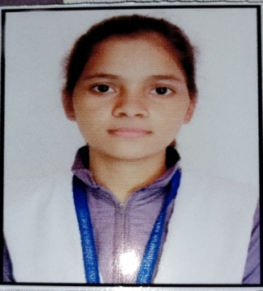
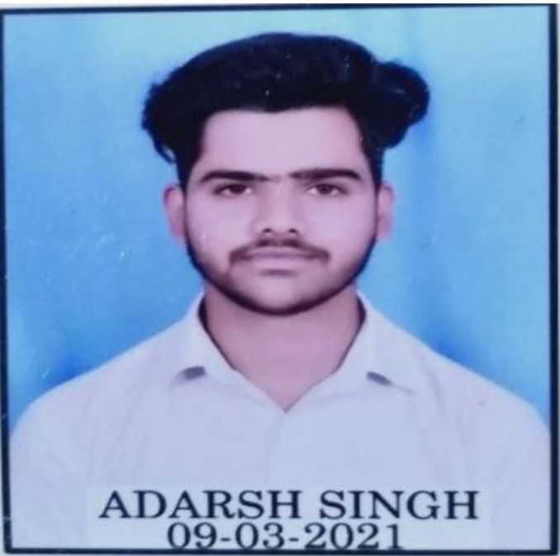
Our Project Team
This is our team who have worked together on our project which we are going to demonstrate today.
ABHISHEK JI
(SPI/VTME/2023/051)
SUSHIL YADAV
(SPI/VTME/2023/032)
NISHA PAL
(SPI/VTME/2023/017)
PAL ROSHAN KUMAR
(SPI/VTME/2023/012)
ADARSH SINGH
(SPI/VTME/2023/037)

Slide 4

SOFTPRO INDIA
Company Introduction
Computer Technologies (P) Limited
Bridging The Technology GAP

Slide 5
Softpro Infographic
2004
2008
2014
Softpro India Computer Technologies (P) Ltd
Softpro Learning
Center
Softpro Innovations
(P) Ltd
Software Development Division
Training & Internship Division
R&D and Automation Division
Agro Production Division
E-Learning Division
Softpro Foods
(P) Ltd
POLYPREP
Knowledge @Your Doorstep
2018
2020
http://www.trainingatsoftpro.com

Slide 6
About Softpro
Softpro India Computer Technologies (P) Ltd is a complete Technology Services and Solutions provider to the clients. It is an ISO 9001:2015 Certified Company, incorporated in the year 2004, by Technocrats from IIT Kanpur and IET Lucknow. The Company is devoted to provide Software Solutions to patrons in verticals like Manufacturing, IT Services, Pharmaceutical and Education Sector. Softpro is an acclaimed member of UPDESCO which facilitates software development in government sectors in UP.
Softpro Innovations is a Revolutionary Sector and the Part of the Organization that specializes in implementing the Engineering Ideas into Existence. The Sector focuses on Research and Development of Technologies including Internet of Things (IoT), Robotics, Machine Learning, Advanced Embedded Systems etc., to maintain the standards of Industry and to support emerging engineering graduates and the IT Sector.

Slide 7
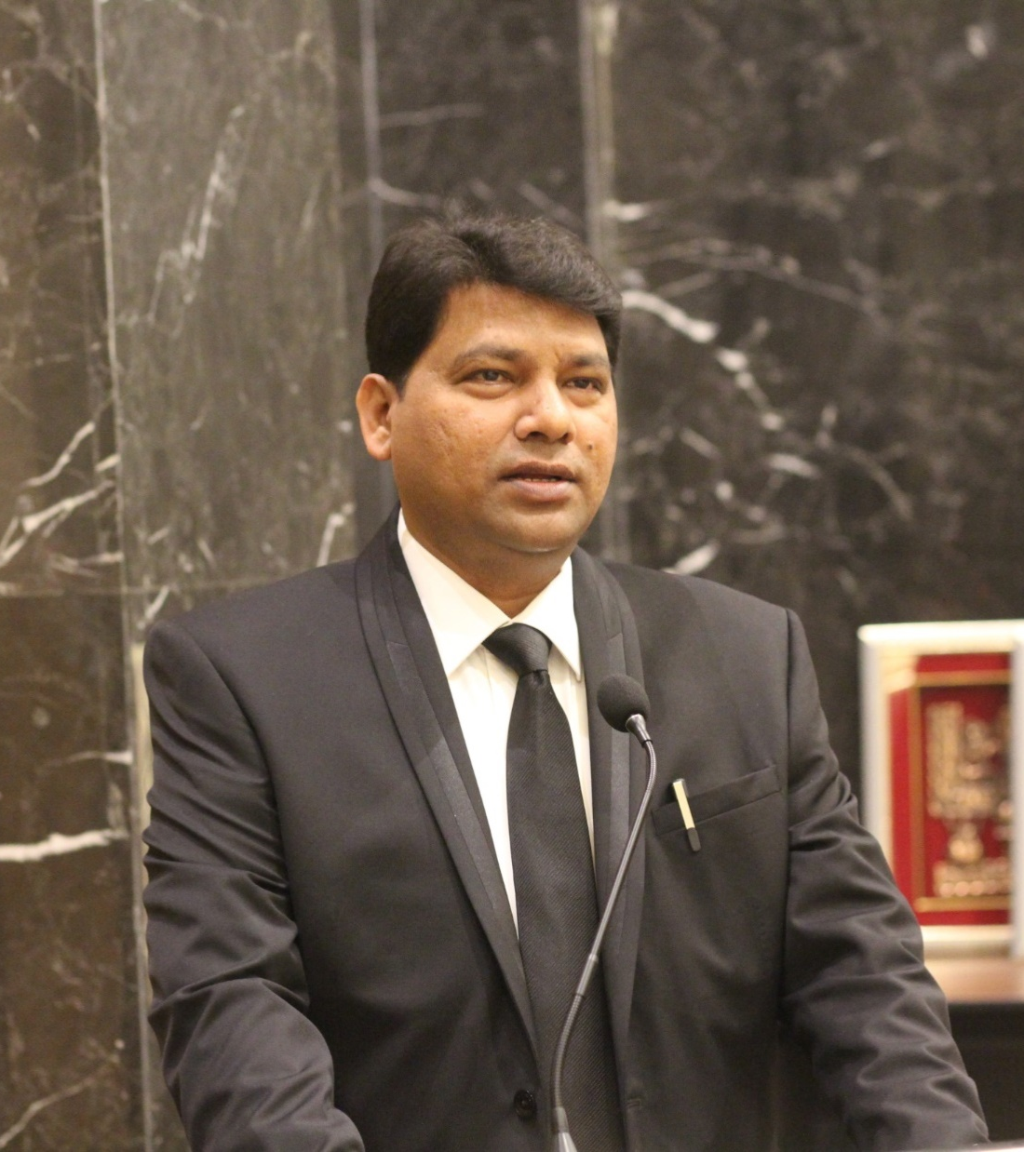
FOUNDER DIRECTOR
SOFTPRO GROUP OF COMPANIES
MD & Chairman
Softpro Group of Companies
Lucknow
Member
Academic Council, IET Lucknow
Board of Technical Education, Lucknow
BOS – Dr. R L Awadh University, Ayodhya
Ex Member – Executive Council
Dr. A P Abdul Kalam Technical University,
Lucknow
Er. Ajay Chaudhary
B.TECH (1995) IET LUCKNOW
He is carrying an experience of 25 years which also includes international work experience of South Africa, Malaysia, Singapore, Kenya & Tanzania.

Slide 8
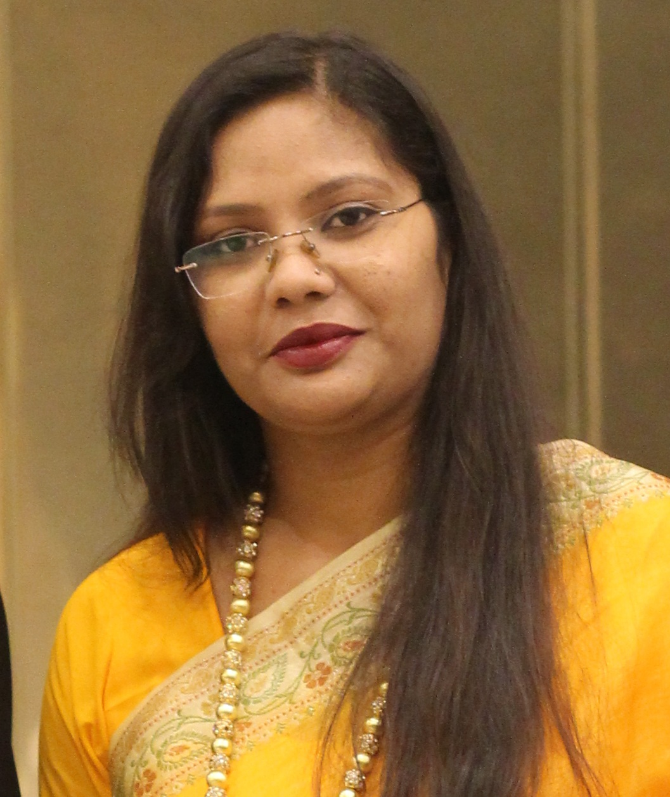
CHIEF EXECUTIVE OFFICER
SOFTPRO GROUP OF COMPANIES
Co-Founder
Parivartan ‘Ek Salah’
NGO Under CSR of Softpro group
MCA
JIWAJI UNIVERSITY, GWALIOR
Ex. Employee – Wipro Technologies
Mysore
She is one of the founding members of Softpro Group. In her
working tenure of 14 years, she worked for clients of national
and international repute. She started her career working with IT Giant “Wipro Technologies, Mysore”, gradually shifting
to Lucknow and associating with Softpro Group.

Slide 9
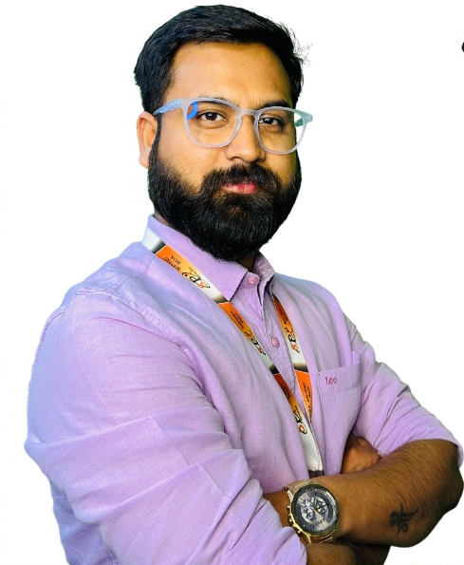
MY CONSULTANT
Name: Er. Akhil Srivastava
Designation: Senior Consultant
Qualification: M.Tech in Structural Engineering/B.Tech/Diploma
Experience : 07+ Years
Er. Akhil Srivastava is a highly experienced software consultant in Civil and Mechanical Engineering, with over 7 years of expertise. He excels at applying innovative software solutions to engineering challenges, bridging the gap between technology and traditional practices. He not only excels as a software consultant but also shines as a dedicated mentor and advocate for students pursuing their dreams in Civil and Mechanical engineering. His versatility and commitment to staying current with industry trends make him a trusted partner for organizations seeking efficient and innovative solutions in these fields.

Slide 10
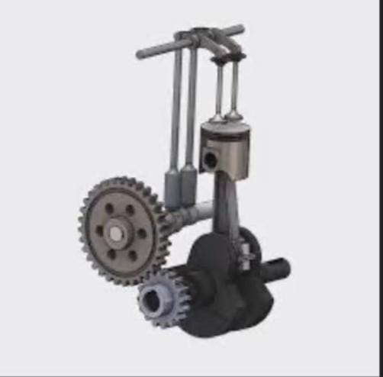
<SINGLE-CYLINDER ENGINE>
Assembly
PROJECT OBJECTIVES
ENGINE TYPE: INTERNAL COMBUSTION , SINGLE-CYLINDER ENGINE.
DISPLACEMENT: DEFINE THE ENGINE DISPLACEMENT IN CUBIC CENTIMETER OR LITRE.
POWER OUTPUT: SPECIFY THE DESIRED POWER OUTPUT IN KILOWATTS OR HORSEPOWER.
FUEL TYPE: INDICATE WHEATHER IT’S A GASOLINE,DISEL,NATURAL GASE, OR OTHER TYPES OF ENGINE.
COMPRESSION RATIO: SPECIFY THE COMPRESSION RATIO FOR OPTIMAL COMBUSSION.

Slide 11
Project Specifications
A single-cylinder engine assembly typically consists of:
1.Cylinder: Houses the piston.
2.Piston: Moves up and down in the cylinder.
3. Connecting Rod: Connects the piston to the crankshaft.
4. Crankshaft: Converts piston’s linear motion into rotational motion.
5. Spark Plug: Ignites the air-fuel mixture.

Slide 12
Project Details
Methodology
DESIGNING A SINGLE-CYLINDER ENGINE ASSEMBLY IN SOLIDWORKS INVOLVES SEVERAL STEPS.HERE’S A METHODLOGY TO GUIDE YOU THROUGH THE PROCESS:
STEP BY STEP PROCEDURE FOR SOLIDWORKS ANALYSIS
PROJECT PLANNING
ASSEMBLY CREATION
SOLIDWORK SETUP
VALIDATION
COMPONENT MODELING

Slide 13
Results
Crankshaft
Converts the linear motion of the piston into
rotary motion, providing power to the output
shaft.
Working
In an internal combustion engine, the piston
plays a crucial role in the process of generating power. Here's a simplified overview of the
piston's work in an engine:

Slide 14
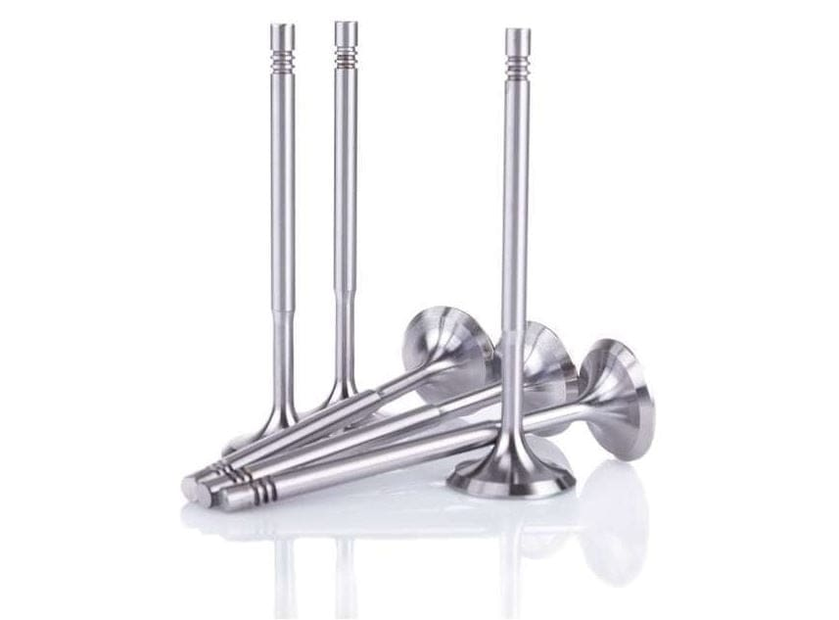
Valves
Regulate the flow of air and fuel into the cylinder and the expulsion of exhaust gases.
Working
Valves are crucial components in an internal combustion engine, responsible for controlling the flow of air and fuel into the combustion chamber (intake valves) and the flow of exhaust gases out of the combustion chamber (exhaust valves). Here's how intake and exhaust valves work in an engine:

Slide 15
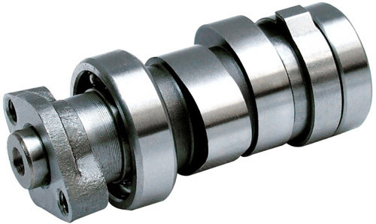
Camshaft
Controls the timing of valve openings and
closings, vital for four-stroke engines.
Working
The camshaft is another critical component in an engine, responsible for controlling the opening
and closing of the engine's intake and exhaust
valves. Here's how a camshaft works:

Slide 16
Piston
A movable component inside the cylinder that
compresses the air-fuel mixture and converts
reciprocating motion into rotational motion.
Working
In an internal combustion engine, the piston
plays a crucial role in the process of generating
power. Here's a simplified overview of the
piston's work in an engine:

Slide 17
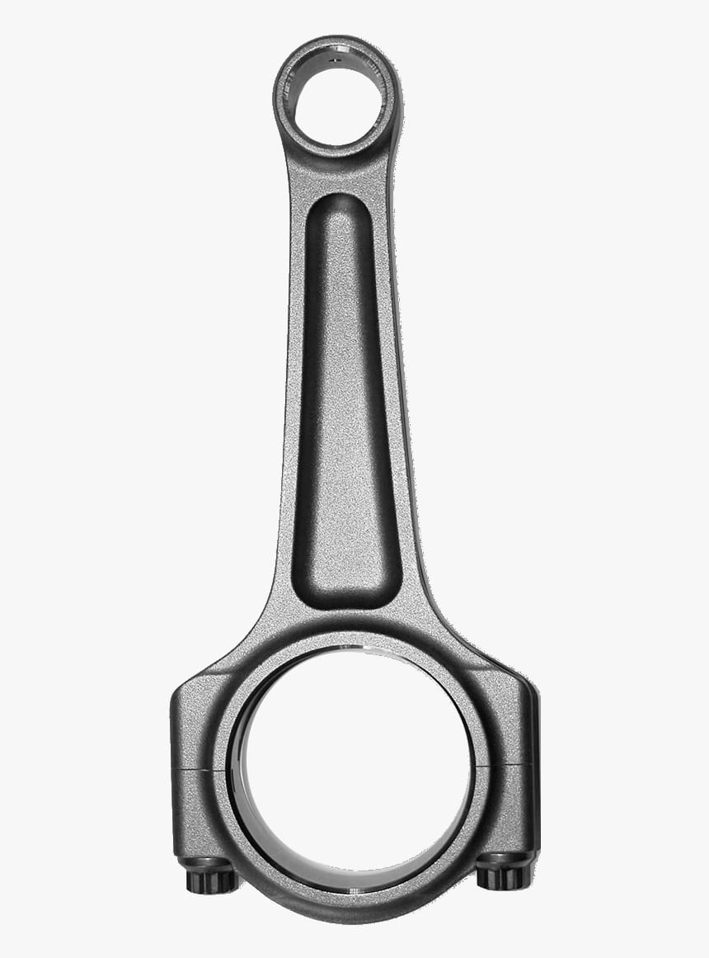
Connecting Rod
A connecting rod in an engine is a rod-shaped component that links the piston to the
crankshaft, converting the piston's
up-and-down motion into rotational motion to
generate power.
Working
A single-cylinder engine’s connecting rod connects the piston to the crankshaft, converting linear motion into rotational motion, powering the engine.

Slide 18
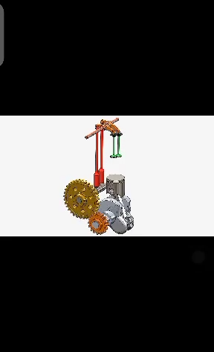
Image
Animation
Final
Assembly

Slide 19
CONCLUSION
Designing a single-cylinder engine involves considerations for it’s cylinder ,piston , crankshaft, valves, timing , fuel and ignition systems , cooling , and emissions, with a focus on simplicity and efficiency foe various applications like small vehicles and equipment.

Slide 20
Thank you
Happy Learning

